Slide 1
303: Understanding Reactive Attachment Disorder (RAD)

Slide 2

Introduction
Preliminaries
Outline of workshop
Tuning in

Slide 3
What’s In It For Me?
RAD Training Needs

Slide 4
Learning Objectives
Define and describe Reactive Attachment Disorder (RAD)
Recognize how the diagnosis of RAD differs from the diagnoses of Disinhibited Social Engagement Disorder, Posttraumatic Stress Disorder, Sensory Processing Disorder, and Attention Deficit Hyperactivity Disorder
Identify the evaluation procedures and screening tools used to diagnosis RAD
Recognize current therapeutic techniques for RAD
Identify effective case management, parenting techniques and resources

Slide 5
Competencies
303.3 The child welfare professional knows common emotional disorders of children and the behavior indicators and dynamics of these disorders, and can refer the child to the proper professional for further assessment and/or treatment

Slide 6
Agenda
Introduction
Definition and symptoms of RAD
Related Disorders and Differential Diagnosis
Case Management
Interventions
Parenting Techniques
Summary and closing

Slide 7
Poll
Think about your response to separating from the person(s) you are MOST attached to for 6 months. What would you want?
To feel secure, I would not need any contact.
To feel secure, I would want monthly contact.
To feel secure, I would want weekly contact.
To feel secure, I would want daily contact.
To feel secure, I would tell them don’t go!

Slide 8

Section II:
Definition and Symptoms
DSM-5 definition of RAD
RAD symptoms
Attachment

Slide 9
Definition and Symptoms of RAD I
A consistent pattern of inhibited, emotionally withdrawn behavior toward adult caregivers, evident before age 5, and manifested by both of the following:
  Rarely or minimally seeks comfort when distressed
  Rarely or minimally responds to comfort offered when distressed
A persistent social and emotional disturbance characterized by at least 2 of the following:
  Minimal social and emotional responsiveness to others
  Limited positive affect
  Episodes of unexplained irritability, sadness, or fearfulness which are evident during nonthreatening interactions with adult caregivers
(American Psychiatric Association, 2013)

Slide 10
Definition and Symptoms of RAD II
Child has experienced a pattern of extremes of insufficient care (pathogenic care) as evidenced by at least one of the following:
  Persistent disregard of the child’s basic emotional needs for comfort, stimulation, and affection (i.e., neglect)
  Persistent disregard of the child’s basic physical needs.
  Repeated changes of primary caregiver that prevent formation of stable attachments (e.g., frequent changes in foster care)
  Rearing in unusual settings such as institutions with high child/caregiver ratios that limit opportunities to form selective attachments
Not due to Autism Spectrum Disorder
(American Psychiatric Association, 2013)

Slide 11
Beliefs: About Self and the World
People are untrustworthy and inconsistent
World is chaotic, unpredictable and unsafe
Nothing I say or do has an impact, not on others, myself or situations
My needs will only be met through my own efforts: I have to do it all myself
I am worthless, unlovable and bad
I am unsafe and weak
Caretakers are unresponsive, unreliable and dangerous
The world is hostile and dangerous
(Cross, 2003)

Slide 12
Child of Rage: A Story of Abuse Documentary:
Video Clips of Parts I & II:
http://www.youtube.com/watch?v=ME2wmFunCjU&feature=youtube_gdata_player
(Source: HBO in association with The National Committee for Prevention of Child Abuse, 1990)

Slide 13
Small Group Discussion
Questions:
What do you think the girl’s feelings and beliefs are about herself?
About her family?
About her sibling?

Slide 14

Newborn Video Activity
As you watch this video, identify components of attachment making sure to include:
Eye contact
Touch
Feeding
Movement
Smiles

Slide 15
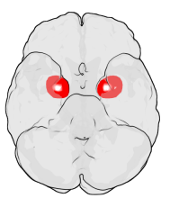
Brain Development (Neurobiology) and Attachment
Frontal Lobes
  Manages manage impulse control,
  social reasoning, organization
  and planning
Amygdala
  Assesses threats and danger in the
  environment and results in fight, flight
  or freeze responses
  (Perry & Szalavitz, 2006,)

Slide 16
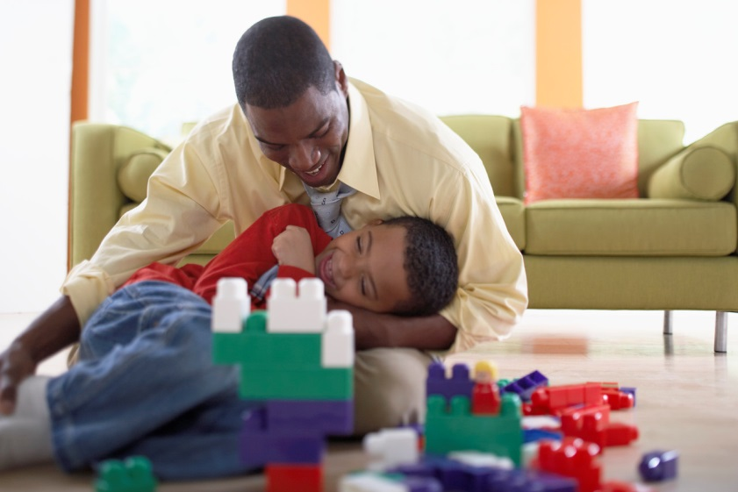
Normal Cycle of Attachment
infant feels need (hunger, pain, attention)
infant is aroused and expresses need (cry)
response/gratification (need is promptly met in nurturing way)
relief/relaxation (infant feels relief and relaxes, develops TRUST)

Slide 17

Normal Cycle of Attachment
Need
Relief Arousal
Relaxation Expression
Response Gratification

Slide 18


Disrupted Cycle of Attachment
Need
Discomfort/Fear/ Arousal
Anxiety -> Expression ->
Lack of Trust in Apathy
Others & Lack of
Empathy
No Response -> Anger

Slide 19
Attachment Disruptions Signs & Symptoms: Behaviors
INFANCY | TODDLER | SCHOOL AGE | ADOLESCENCE
Lack of eye contact Inability to sooth Does not express needs Possible low development and weight gain | Excessive tantrums Difficulty self-regulating Affectionate on their own terms Frozen watchfulness | Tantrums continue Difficulty forming close peer relationships Possible encopresis/ Enuresis Possible lying, hoarding, stealing, destruction of property | Possible drug/alcohol abuse Difficulty forming intimate relationships

Slide 20
Attachment Disorder Cycle
infant feels need (hunger, pain, attention)
infant is aroused and expresses need (cry)
there is no response, or response is angry/punitive
there is not relief/relaxation (infant develops anger/rage and learns not to depend on caregivers for need satisfaction)

Slide 21
Attachment Activity
  In your table group:
  Review the assigned Attachment Activity card
  Read the materials referenced in the Child and Adolescent Development Resource Manual
  Record findings on your flip chart paper
  Identify a reporter
  Be prepared to report findings to the large group

Slide 22
Continuum of Attachment
SECURE | ANXIOUS | DISORGANIZED | NONATTACHED
Comfortable with closeness and trust Felt security Vulnerability acceptable Positive working model Individuality, togetherness balanced | Resists or ambivalent about closeness or trust Moderately controlling and insecure Negative working model Rejecting or clingy | Unable to trust or be close May lack remorse Aggressive and punitive control Negative working model (severe) Pseudo-independent | Unable to form emotional connections Lacks conscience Predatory behaviors Negative working model (severe) Extreme narcissism
(From: Attachment, Trauma, and Healing, p. 94)

Slide 23

Risk Factors for Pathogenic Care
  abuse
  neglect
  maternal postpartum depression
  maternal mental illness
  substance abuse of parent
  inexperienced parent
  inconsistent caregiving
  many different caregivers

Slide 24

Section III:
Related Disorders and Differential Diagnosis
Symptom comparison
Diagnosis and treatment

Slide 25
Disinhibited Social Engagement Disorder (DSED)
Attachment present/not
Reduced or absent reticence to approach and interact with unfamiliar adults
Overly familiar behavior (verbal or physical violation of culturally sanctioned social boundaries)
Diminished or absent checking back with adult caregiver after venturing away
Willingness to go off with an unfamiliar adult with minimal or no hesitation
(American Psychiatric Association, 2013)

Slide 26
Posttraumatic Stress Disorder (PTSD)
Symptoms of avoidance and emotional numbing
Symptoms of intrusive memories
  Flashbacks
  Nightmares
Symptoms of altered cognitions and mood
(American Psychiatric Association, 2013)

Slide 27
Sensory Processing Disorder (SPD)
Difficulty processing sensory input
  Sight
  Sound
  Taste
  Smell
  Touch
  Proprioceptive (body positioning in space)
  Vestibular (balance)
Hyper (over) or hypo (under) reactive in one or more senses
(Sensory Processing Disorder Foundation, 2013)

Slide 28
Attention Deficit Hyperactivity Disorder (ADHD)
Primary feature is a persistent pattern of inattention and/or hyperactivity-impulsivity that interferes with functioning or development
Present before age 12 and manifests in two or more settings
Three subtypes within the disorder
  Predominantly Inattentive
  Predominantly Hyperactive/Impulsive
  Combined
(American Psychiatric Association, 2013)

Slide 29
Evaluation Process for RAD
Direct observation of the baby's or child's interaction with his or her parents or caregivers
Details about the baby's or child's pattern of behavior over time; examples of the baby's or child's behavior in a variety of situations
Information about how the baby or child interacts with parents or caregivers as well as others, including other family members, peers and teachers
Questions about the baby's or child's home and living situation since birth
An evaluation of parenting and caregiving styles and abilities (Mayo Clinic, 2013)

Slide 30
Attachment Behavior Q-SET
Child readily shares with mother or lets her hold things if she asks
When child returns to mother after playing, he is sometimes fussy for no clear reason
When he is upset or injured, child will accept comforting from adults other than mother
Child is careful and gentle with toys and pets
Child is more interested in people than things
When child is near mother and sees something he wants to play with, he fusses or tries to drag mother over to it

Slide 31
RAD-Q SAMPLE
My child acts cute or charms others to get them to do what s/he wants
My child has trouble making eye contact when adults talks to him/her
My child pushes me away or becomes stiff when I try to hug him/her, unless s/he wants something from me
My child has a tremendous need to have control over everything, becoming upset if things don’t go his/her way

Slide 32
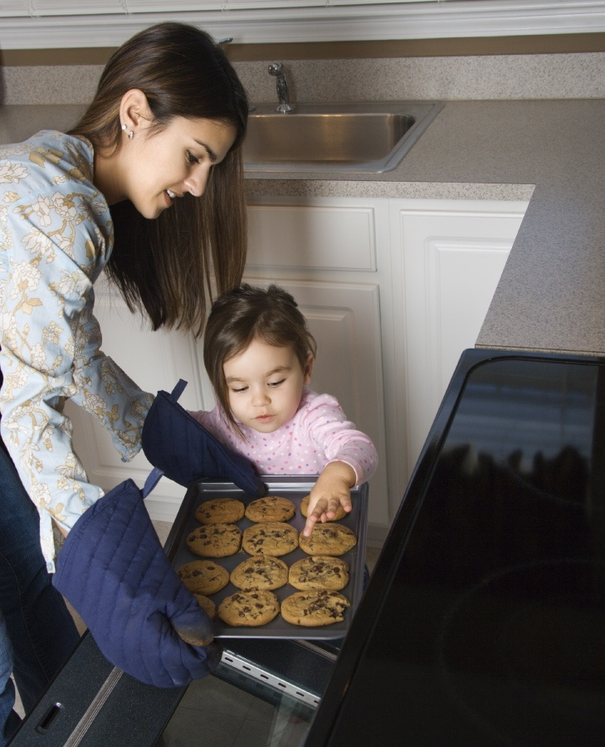
Section IV:
Case Management
Principles of Case Management
Case Studies
Daily Review

Slide 33
Case Management Activity
In small groups, discuss your assigned topic area:
1. Purpose and value of pre-placement visits (child with foster family and worker with family of origin);
2. Purpose and value of post-placement visits (worker with child, family of origin and foster family);
3. Purpose and value of contacts with family of origin during placement (both child and worker); or
4. Role of the foster family when child leaves their home.
Write/discuss your assigned concept and how it might apply to a child with RAD
Prepare to share

Slide 34
Pre-Placement Visits
Diminish fears and worries of the unknown.
Can be used to transfer attachments.
Initiate grieving process.
Empower new caregivers.
Encourage making commitments for future

Slide 35
Post-Placement Contacts
Prevent denial/avoidance.
Resurface emotions about separation at manageable levels.
Provide opportunities for support of feelings.
Decrease magical thinking.
Decrease loyalty issues.
Continue transference of attachment/empowerment of new caretakers.

Slide 36

Contact with Family of Origin
Assess:
  Parent-child attachment
  Parenting skills
  Nature of family interactions &
  Tasks necessary for reunification;
Facilitate grieving process;
Decrease loyalty conflicts;
Strengthen attachments and bonds;
Facilitate changes in family
relationships; and
Facilitate reunification.

Slide 37

Resource Family Role
Acknowledge mixed feelings of child;
Allow expression of feelings;
Let child know they care;
Provide clear explanations for
the move;
Maintain contact; and
Accept regression.

Slide 38
Case Studies Activity
Madison (age 16) and Meghan (newborn)
Tasha (age 4 ½)
Tiana (age 8)
Carrie (age 3)

Slide 39

Day 1: Review
Definition of RAD
Description of RAD
Attachment cycle
Differential diagnosis
Case management principles

Slide 40

Day 2: Overview
Interventions
  Medication
  Therapy
  Parenting Techniques
Resources
Closure

Slide 41

Questions?

Slide 42
303: Understanding Reactive Attachment Disorder (RAD)
Day 2

Slide 43
Day 2 Agenda
Interventions
  Types of therapy
Parenting techniques
Resources
Summary and closing

Slide 44

Interventions
Attachment therapy
Characteristics of an attachment therapist
Theraplay
Eye Movement Desensitization Reprocessing
Neurofeedback
Occupational therapy for sensory integration

Slide 45
Therapy
Q: What factor does all therapy depend upon for success?
A: TRUSTING RELATIONSHIP AND RECIPROCITY BETWEEN THERAPIST AND CHILD
Q: What characteristics of children with RAD would interfere with success in traditional therapy?
A: LACK OF TRUST AND DEVELOPMENT OF RELATIONSHIPS, MANIPULATIVE

Slide 46
Principles of Attachment Therapy
Child must be motivated to change
Utilizes a systems model
Includes the caregiver(s) in the treatment
Deals with early trauma through conscious or unconscious memory
Corrects irrational thinking (beliefs about self and the world)
Facilitates attachment to caregivers through nurturance

Slide 47

Therapist Provides
Structure
Attunement
Empathy
Positive affect
Support
Reciprocity

Slide 48
Attachment Therapy
Focus is on building attachment between child and parents through nurturing touch, structure, attunement, empathy, support, positive affect, and reciprocity
Sometimes holding is used to reduce “alarm” reaction
  Holding provides deep pressure sensation, which the brain interprets as safe and calming.
  In holding, the child is better able to process information and use their cortex for new learning
Promotes self-regulation
Provides structure and sets limits on the child with acting out behaviors in a safe, nurturing environment
Facilitates corrective experiences when others are in control
Child of Rage, Part III

Slide 49
Attachment Therapy
Pros
Cons
Addresses alarm reaction
Helps with self- regulation of alertness and activity level
Sets limits in safe environment
Reduces need for control on the part of the child
News reports of child's death in "holding therapy" impact parents’ willingness to try this technique
Some feel this can re-traumatize the child, especially if sexually abused
Ongoing debate over parent vs. therapist holding

Slide 50
Theraplay
Addresses four areas: structure, engagement, nurturing touch, challenge
Started by Ann Jernberg in her role as director of psychological services for Head Start
Theraplay was registered as a service mark in 1976; this means you have to be trained to call yourself a Theraplay therapist.

Slide 51
Theraplay Video
View the video Theraplay and identify the Theraplay
principles of structure, engagement, nurturing, and
challenge of identified in the video.
http://www.theraplay.org/

Slide 52
Theraplay
Therapist takes charge, planning and structuring sessions to meet child's needs, rather than waiting for the child to lead way
Treatment focuses on the relationship, not the inner psyche
Nurturing touch is an integral part of the interaction

Slide 53
Theraplay
Therapist remains firm in the face of resistance, passive or active
Active, physical, interactive play. No symbolic play with toys; little talk of problems
Geared to the child's developmental level
Parents and child learn new ways of interacting
Therapist usually steps into the parental role to model for the parents

Slide 54
Theraplay
Pros
Cons
Short term
Enjoyable
Facilitates attachment between parents and child
Helps the child accept control and structure from others
Does not deal with underlying trauma

Slide 55
Eye Movement Desensitization and Reprocessing (EMDR)
Used for overcoming anxiety, stress and trauma
Rhythmical stimulation in ways that stimulate the brain's information processing system
Does not require extensive delving into past trauma
View the video Small Miracles that shows how EMDR is used with children
http://www.emdrinaction.com/short-videos-introduction-emdr

Slide 56
EMDR
Pros
Cons
Facilitates trauma work without re-traumatizing child
Does not help parent with child's behaviors
Does not directly facilitate attachment

Slide 57
Neurofeedback I
Learning strategy that enables persons to alter their brain waves and exercise the brain’s own regulatory mechanisms
Used with many conditions and disabilities in which the brain is not functioning as well as it might
When information about a person's own brain wave characteristics is made available to him, he can learn to change them (exercise for the brain)
Used as well for LD, ADHD, sleep disorders, pediatric migraines, and affective disorders such as anxiety and depression.

Slide 58
Neurofeedback II
Sensors are placed in designated areas, which track the brain waves on a screen for the therapist
A video game screen is placed in front of the client
Game is controlled by controlling the brain waves, so the client learns to produce the desired brain waves and diminish the undesired waves
View the video to learn more about how neurofeedback works
http://www.eeginfo.com/neurofeedback-videos-media.htm

Slide 59
Neurofeedback
Pros
Cons
Enjoyable
Normalizes brain function to allow for improved information processing and self regulation
Does not involve direct trauma work
Does not resolve trauma
Does not directly facilitate attachment
Does not help parent with child's behaviors

Slide 60
Sensory Integration
Used by specially trained Occupational Therapists to help the children normalize their sensory systems
Often children with RAD are overly sensitive to ordinary sensory input
  Sight, sound, taste, smell, touch, proprioceptive, vestibular
Sensory defensiveness puts them into "fight/flight mode
View the video to learn more about the seven senses that provide input to the brain throughout each day
http://www.youtube.com/watch?v=iNEXf7MA884

Slide 61
Sensory Integration
Pros
Cons
Normalizes brain function to allow for improved interactions
Allows child to accept parental nurturing
Can improve attention
Can improve self regulation
Not all occupational therapists are well trained in this area

Slide 62
Key Questions to Ask Treatment Specialists:
Do you have previous experience working with children diagnosed with Reactive Attachment Disorder?
How will you address/treat their attachment disorder?
Do you involve the current caregivers/reunification caregivers in treatment?
If the child will need to relocate from a group home/treatment facility, when will you begin transfer planning? How will you facilitate the transfer?

Slide 63

Section VI: Parenting Techniques

Slide 64
Attachment Parenting: Lego Level
The child plays near a parent with basic toys
Play is simple and requires the child to interact in a creative way with toys
Toys are Legos, puzzles, coloring books, etc.
Only a few toys are used at a time
Parent chooses the play activity, thereby maintaining control

Slide 65
Attachment Parenting: Steel Box/Velvet Lining
Create a small, highly structured world for the child where they can experience safety and security and begin to learn to trust the world and the people around them
Children need to first relate to people, eliminating 'things' from their life helps them focus on relationships
The child's room should be almost empty, bed and dresser only

Slide 66

Principles of Attachment Parenting
Take care of self first
Engender respect
Create structure and consistency
Establish consequences and restitution
Provide nurture
Process feelings
Provide child with success

Slide 67
Take Care of Self First
If you don't, you will not be able to help the child heal:
1. Healthy food
2. Adequate rest
3. Respite if possible
4. Other healthy/supportive relationships
5. Locks
6. Alarms
7. Every family member has personal supplies in portable container, locked away from child as needed (shampoo, soap, toothbrush & paste, etc.)

Slide 68
Engender Respect
Child should give eye contact and speak respectfully when addressed
Compliance is expected:
  “Puppy practice”
    Come, sit, stay, go, no, stop, watch me…
    Have child practice basic compliance- send to other room, when caregiver says the child's name, child is to come, give caregiver eye contact, and say "Yes, _____ (person’s name)?"
    Repeat several times until child complies readily
    Practice other commands other days
    Make up “games” to play to help teach compliance/respectful actions
Continue puppy practice until child consistently complies with all requests, both in and out of practice situations

Slide 69
Create Structure & Consistency
Allows the child to feel safe and secure:
1. Start strict, loosen up later
2. Few simple rules
3. Same rules everywhere with everyone
4. Same structure every day (routines)

Slide 70
Create Structure & Consistency: Responsibility
Teaches the child reciprocity and competence:
1. Child should have developmentally age appropriate chores (e.g., a six year old can make their own bed, clean their own room and sweep the kitchen floor with a broom; if your 16 year old typically functions at a six-year-old level, stick to this level of chores and do not give a child complex chores or those requiring power tools until they can consistently do simpler chores well)
2. Demonstrate the chore in precise steps
3. Give clear expectations

Slide 71
Creating Structure & Consistency:
Responsibility (Cont’d)
4. Expect child to perform exactly as instructed
5. If child does not do the chore correctly, and you're sure they can do it and understand what you expect, lower your expectations; they are showing that you aimed too high - choose a chore closer to their developmental level. This allows for success, which builds self-esteem
6. Child repeats simple chore until consistently done

Slide 72
Creating Structure & Consistency:
Responsibility (Cont’d)
7. Move on to more complex chores when child shows readiness
8. Keep chores to what could be done by a child that age (developmentally age appropriate)

Slide 73
Establish Consequences & Restitution
Teach the child to think before acting and to take responsibility for their own actions:
Be consistent in applying consequences BUT inconsistent in what consequences are given
2. Do NOT need to give child a consequence immediately (unless toddler)
3. Require restitution for any damage

Slide 74
Establish Consequences & Restitution (Cont’d)
4. Consequences should be natural or logical and in proportion to offense
5. Consequences and restitution can wait until child is ready
6. Keep a notebook or you'll get lost!

Slide 75
Provide Nurture
Helps the child to feel lovable and worthwhile.
Child needs:
  Touch- use deep touch pressure, hold hands, rub lotion or powder on hands and give hugs
  Eye contact- give child smiling eye contact when talking to them and holding them
  Movement- rock child, swing, use trampoline, dance
  Smiles- during eye contact smile at child, see if child smiles back
Sugar- add some sugar to milk, feed child ice cream, candy, etc. as given directly from a parent to child- especially milk and sugar combined like caramels. This simulates a mother's milk, so is the basis for true nurturing

Slide 76
Provide Nurture (Cont’d)
Snuggle time:
  Time for a parent to hold child on or across lap, one arm behind (like infant nursing)
  Rock child, sing, read, talk gently
  DO NOT ask about school or other potentially touchy issues, this is time to get close to child
  Feed child- from bottle, Sippy cup, or spoon
  Encourage eye contact and give smiles
Child may be avoidant- try to persist but not force; child will cooperate when ready

Slide 77
Provide Nurture (Cont’d)
Establish bedtime routine that provides nurture:
  Cuddle with child
  Read
Sing child special song (use familiar tune to create song about child)
Nurture child in other ways throughout the day:
  Fix favorite foods and snacks
  Spend time listening to them
  Do fun things together
Help with hair styling, washing, etc.

Slide 78
Process Feelings
Children with RAD often do not recognize or acknowledge their feelings
They need help feeling safe and learning the right words

Slide 79
Process Feelings (Cont’d)
Identify child's feelings:
  Can use pictures to help child identify feelings at first
  Put words to feelings, both yours and child's
  Model talking about feelings to help child overcome fear of strong feelings
  Say "I'll bet that feels..." or "If I were you, I would feel... about that" (child will correct you if you're wrong)
When child seems out of control, have them sit on the floor next to you with their head on your knee, stroke their back or head and talk out their feelings for them

Slide 80
Provide Child with Success
Increase the child's confidence and improves self-esteem:
1. Keep expectations at developmental level
2. Keep praise specific- "I like the way you cleaned that floor" "You put everything in the right place when you set the table" NOT "You're a good kid“ or "You did a good job”

Slide 81
Provide Child with Success (Cont’d)
3. Add responsibility ONLY after child demonstrates readiness
4. When you need to correct behavior say “I see this is hard for you, I'm going to help you" and lower your expectations
5. Supervise the child so you can pre-empt any negative behavior(s)

Slide 82
Parenting Case Studies
Hartman Family Donyeh (age 18 months)
Jamie (age 14 years) Phillips Family

Slide 83
Resources
Books
Cassettes
Support groups
Online support groups
Videos
www.attachmentcenter.org
www.instituteforchildren.com
www.emdrportal.com
www.eegspectrum.com
http://www.dyadicdevelopmentalpsychotherapy.org/

Slide 84
Summary and Closing
Questions?
Key learning points
Evaluations

